Slide 1
Lecture Notes: JPEG Image Compression

Slide 2
From the Article by Wallace:
Title: The JPEG Still Picture Compression Standard
Source: Communications of the ACM archive
Volume 34, Issue 4 (April 1991)
Special issue on digital multimedia systems
Pages: 30-44
Year: 1991
ISSN: 0001-0782
Author: Gregory K. Wallace
Digital Equipment Corp., Maynard, MA
Publisher: ACM Press New York, NY, USA

Slide 3
The JPEG Still Picture Compression Standard
Joint Photographic Experts Group
A standards committee set up by the CCITT and the ISO.
Tasked in the late 1980’s to generate a general-purpose standard for compression of almost all continuous tone and still-image applications.
Published Standard: “Digital Compression and Coding of Continuous-tone Still Images – Requirements and Guidelines,” ISO/IEC 10918-1:1993(E)
Notes:
The CCITT, now known as the ITU-T (for Telecommunication Standardization
Sector of the International Telecommunications Union), is the primary
international body for fostering cooperative standards for telecommunications
equipment and systems. It is located in Geneva, Switzerland.
ISO is a network of the national standards institutes of 156 countries, on the
basis of one member per country, with a Central Secretariat in Geneva,
Switzerland, that coordinates the system.

Slide 4
JPEG’s Goals for the Standard
Be at or near the state of the art in compression rate and image fidelity.
User decides on the trade-off between image fidelity and compression ratio.
Be applicable to any kind of continuous-tone digital image source (unrestricted with respect to content, complexity, color-range, statistics, etc.)
Have tractable computational complexity for implementation on a wide range of computational hardware.

Slide 5
JPEG’s Modes of Operation
Sequential encoding: each component (band) encoded in a single raster scan
Progressive encoding: progressive coarse–to-fine encoding and decoding of entire image
Lossless encoding: exact recovery of original image
Hierarchical encoding: multiresolution compression with independently retrievable lower-resolution versions

Slide 6
JPEG Codec
RGB →
YCbCr conversion
down sample color
partition into 8×8 blocks
entropy encoder
image
FDCT
quantizer
table spec
table spec
Compressed Data
entropy decoder
de-quantizer
up sample color
YCbCr → RGB
conversion
IDCT
image
table spec
table spec

Slide 7
JPEG Baseline Process
DCT-based process
Source image: 8-bit samples within each component
Sequential
Huffman coding: 2 AC and 2 DC tables
Decoders process scans with 1, 2, 3, or 4 components
Interleaved and non-interleaved scans

Slide 8
Entropy Encoding
Set A = {s₁, …, s_{N}} is called an alphabet.
Each s_{i} ∈ A is called a symbol.
A string over the alphabet is a sequence of symbols, e.g.
s₁₁s₄s₁₀₅s₁₀₅s₄₇s₈₆s₈₆s₃☹s₃₀.
A codeword is a sequence of bits that represents a symbol or string. e.g. 1011000010110111101.
p_{i} = p(s_{i}) is the probability of occurrence of symbol s_{i} in a string.
L_{i} is the length of the codeword for s_{i} in bits.
In the context of Information Theory the entropy is the number of bits on the average need to represent a symbol in set A.

Slide 9
Information Content of a Symbol
If in a signal or message, the symbol s_{i} has occurrence probability p(s_{i}) then a measure of the extraordinariness of the event “s_{i} occurs” is 1/p(s_{i}) – the less likely the event, the more extraordinary it is. The information content of the event is defined as the number of bits required to code the measure of its extraordinariness. That is
is the information content of symbol s_{i}, ⎯ the number of bits needed to code it. I(s_{i}) is a real number, not necessarily an integer.

Slide 10
Entropy Encoding
Given a finite set of symbols with associated probabilities of occurrence,
such that
Then the entropy of A is the expected value
the mean information content of the symbols.

Slide 11
Entropy Examples
1. A = {a,b}; p(a) = 0.5; p(b) = 0.5.
2. A = {a,b}; p(a) = 0.8; p(b) = 0.2.

Slide 12
Entropy Examples
3. A = {a,b,c,d}; p(a) = 0.25; p(b) = 0.125; p(c) = 0.2917; p(d) = 0.3333.
The entropy is usually not integral. How, then can it be coded?
Entropy encoding finds a mapping from the alphabet to the code words such that the average number of bits per symbol (bps) approaches the entropy as the number of symbols increases without bound.
bps = (size of encoded message)/(size of original message).

Slide 13
Code Types
Fixed length: all codewords have the same length (number of bits). E.g. letters A through H encoded as 3-bit binary numbers.
A ↔ 000, B ↔ 001, C ↔ 010, …, H ↔ 111
Variable length: different codewords may have different lengths depending on, for example, their probability of occurrence.
A ↔ 0, B ↔ 10, C ↔ 110, …, H ↔ 11111110
That variable length code is an example of a prefix code, no code is the prefix of another code.

Slide 14
Huffman Coding
Each symbol is assigned a specific code with a length dependent on its frequency of occurrence.
There is a prefix code – no codeword is a prefix of any other codeword.
Is uniquely decodable – only one possible source message.
A Huffman code is the optimal prefix+variable-length code given the probability of occurrence of the symbols inb the message.
Generated with a Huffman tree.

Slide 15
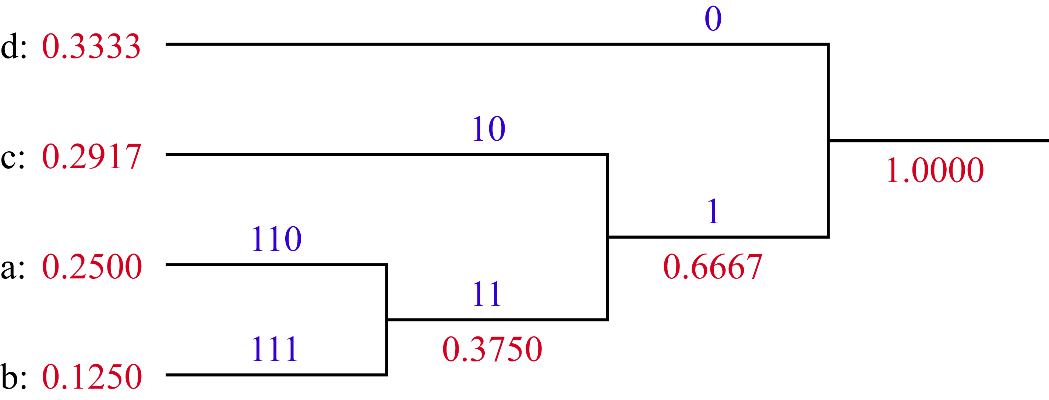
Huffman Tree
Symbols
Probabilities
Codewords

Slide 16
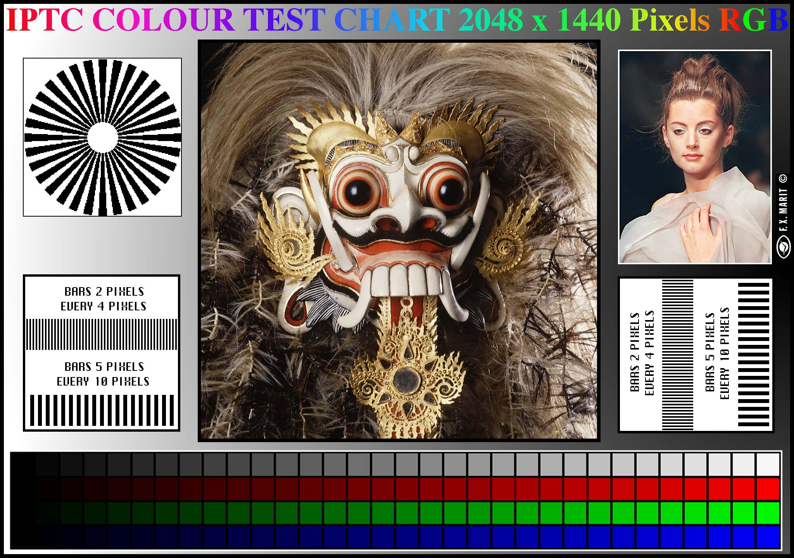
A Standard Color Test Chart

Slide 17
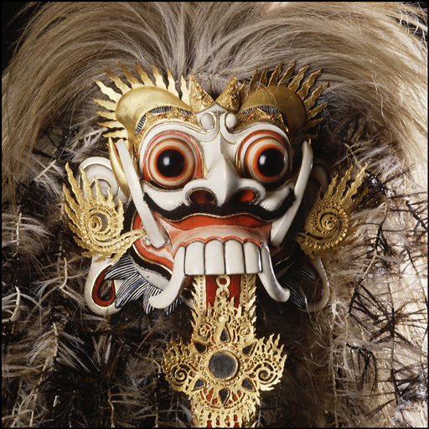
We’ll use the image in some of the following slides.

Slide 18

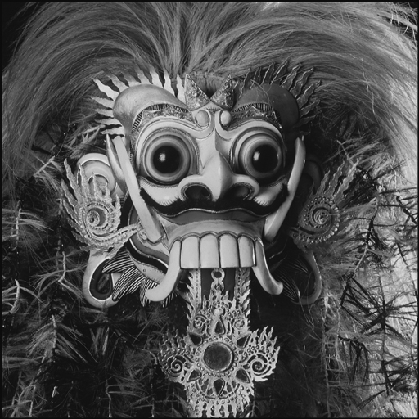
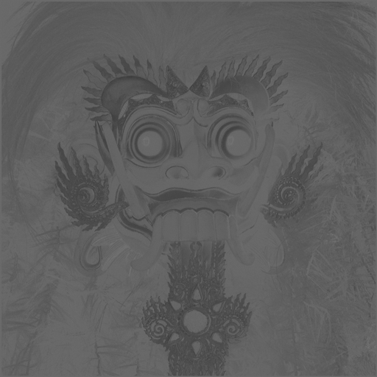
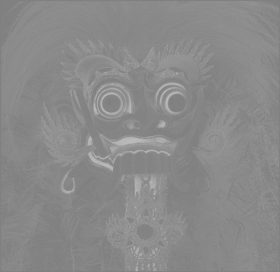
Color Conversion: RGB → YCbCr
→
+
+
RGB
Y
Cb
Cr

Slide 19
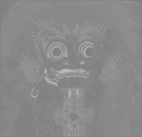
Downsample Color Bands
+
+
→
→
+
+
by a factor of 2
Y
Cb
Cr

Slide 20
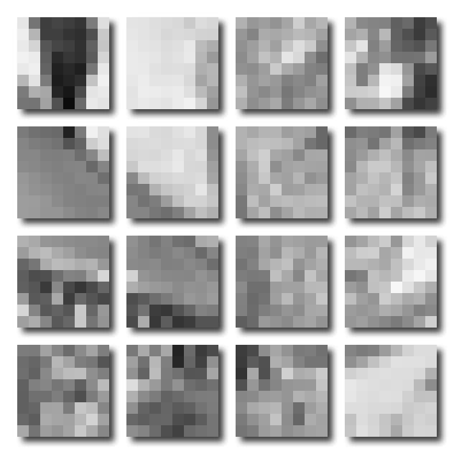
Partition Each Band into 8×8 Blocks

Slide 21
Prep for Forward Discrete Cosine Transform
Each image band is operated on independently.
Each 8×8 image block is operated on independently.
Shift all image values from I∈[0, 2^{P}-1] to I∈[-2^{P-1}, 2^{P-1}-1]. E.g. [0, 255] → [-128, 127].
The FDCT decomposes each block into a set of coefficients with respect to the 64 orthogonal basis functions shown on the next slide.

Slide 22
DCT Functions and Variables
DCT of 8×8 block from I starting at (r,c)
Normalization Factor
2D Cosine Basis Function, (v,u)
r
c
ρ
χ
v
u
- image row index (vertical, increasing down)
- image column index (horizontal, increasing right)
- DCT row index (horizontal wave fronts, vertical propagation down)
- DCT column index (vertical wave fronts, horizontal propagation right)
- DCT row frequency index (vertical, increasing down)
- DCT column frequency index (horizontal, increasing right)

Slide 23
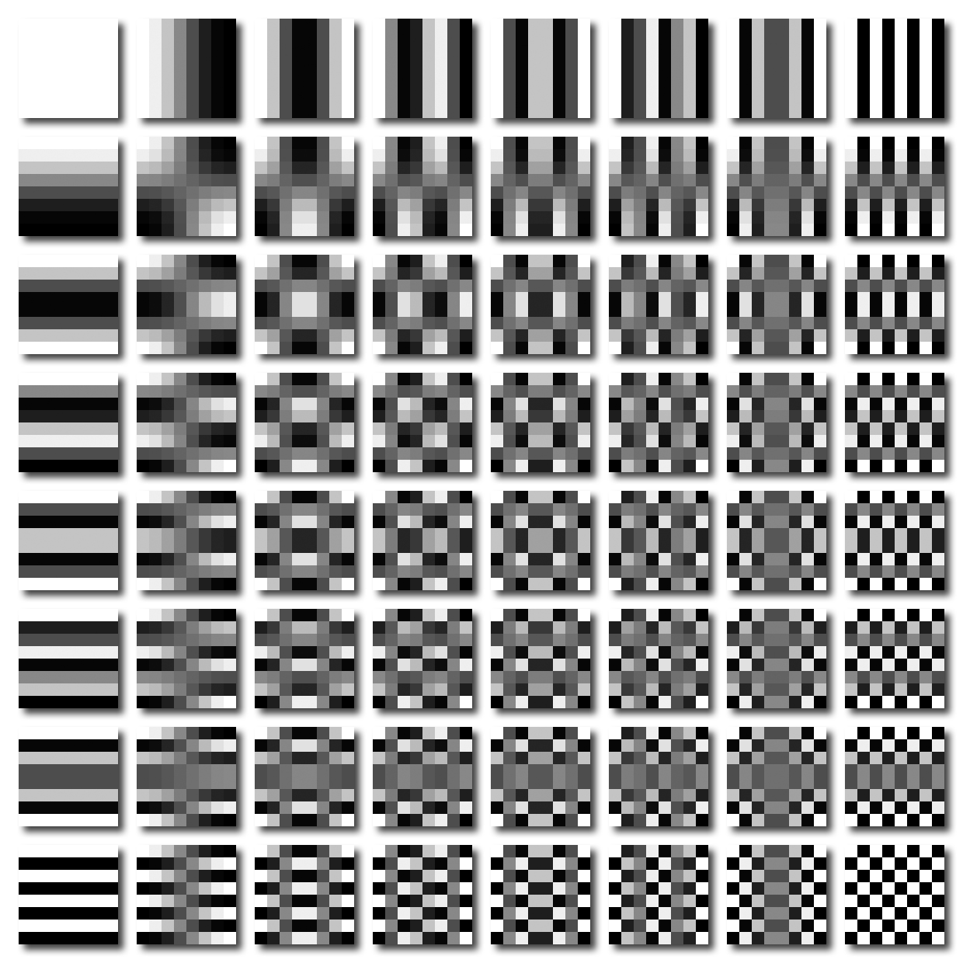
DCT Basis Functions
u = 0
u = 7
v = 0
φ(v, u; ρ, χ )
white = 1 black = -1
ρ
↓
v = 7
χ →

Slide 24

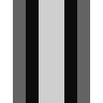




Forward Discrete Cosine Transform
(r, c )  {0,8,16,…,R} x {0,8,16,…,C},
(v, u ) , ( ρ, χ )  {0,…,7} x {0,…,7}.
F{I}(4,4; r,c)
χ →
χ →
χ →
c+χ →
χ →
u →
ρ
↓
ρ
↓
ρ
↓
r+ρ
↓
ρ
↓
v
↓
∑ ∑
×
=
×
=
ρ χ
→
row cos: (v=4, ρ)
col cos: (u=4, χ)
Φ = col cos × row cos
8x8 block of I @ (r,c)
p.w. product
F(v,u;r,c)

Slide 25
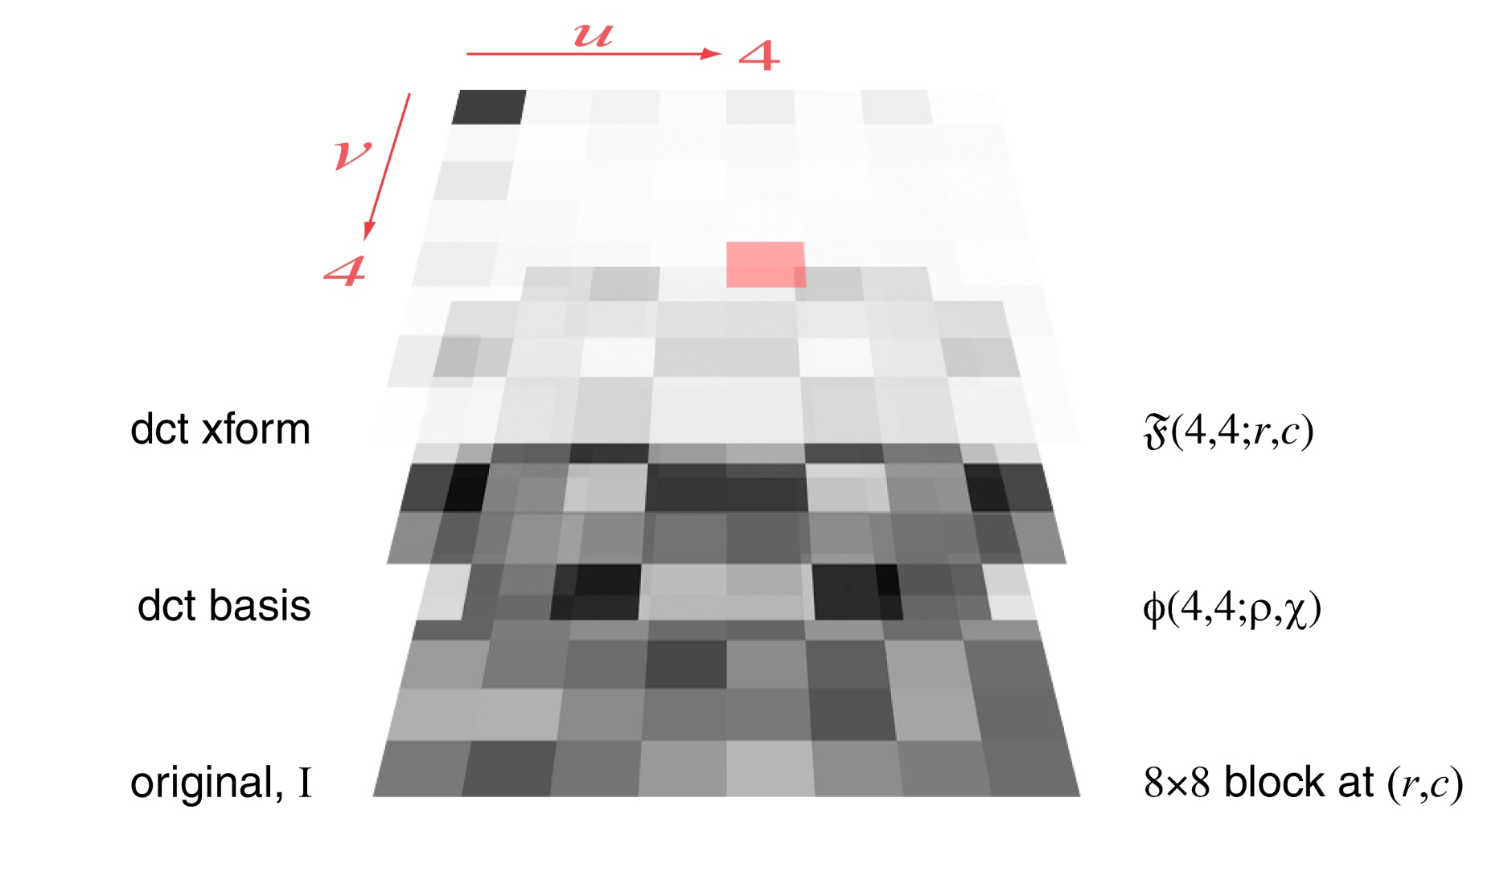
Forward Discrete Cosine Transform
F{I}(0,0;r,c) is the DC component of the 8x8 block from I at (r,c) …
…the others are the AC components, e.g. F{I}(4,4;r,c).
ΣΣ
↑
ρ χ
×
↑

Slide 26
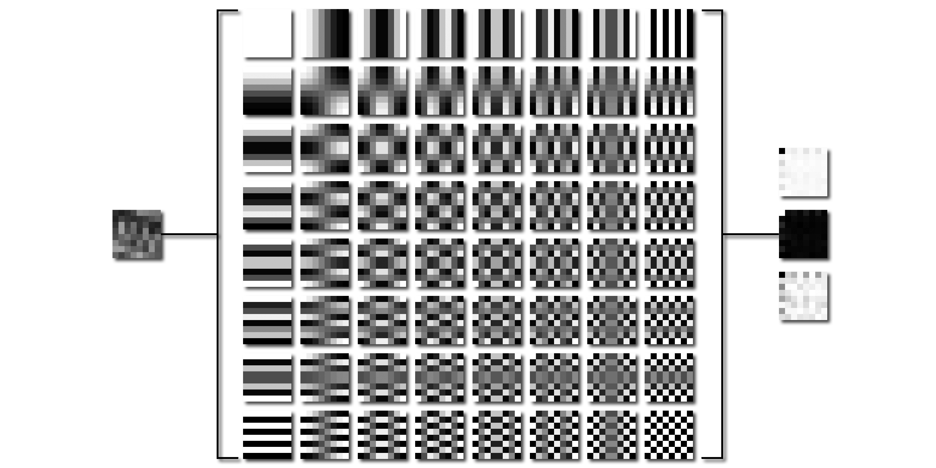
Forward Discrete Cosine Transform
Negative
Input
Output
-log Out.
Neg. & neg. log just for visibility here.

Slide 27
Forward Discrete Cosine Transform
Each value, F(v,u ; r,c), in the 8x8 output is the sum of the pixel-wise product of the 8x8 block that starts at (r,c) in the image and the cosine basis function at row v, column u in the table.
Negative
Input
Output
-log Out.
(r,c )  {0,8,16,…,R} x {0,8,16,…,C},
(v,u )  {0,…,7} x {0,…,7}.
Neg. & neg. log just for visibility here.

Slide 28
Example FDCT Quantization Tables
Luminance Quantization Table
Chrominance Quantization Table
2 | 2 | 3 | 4 | 5 | 6 | 8 | 11
2 | 2 | 2 | 4 | 5 | 7 | 9 | 11
3 | 2 | 3 | 5 | 7 | 9 | 11 | 12
4 | 4 | 5 | 7 | 9 | 11 | 12 | 12
5 | 5 | 7 | 9 | 11 | 12 | 12 | 12
6 | 7 | 9 | 11 | 12 | 12 | 12 | 12
8 | 9 | 11 | 12 | 12 | 12 | 12 | 12
11 | 11 | 12 | 12 | 12 | 12 | 12 | 12
3 | 3 | 7 | 13 | 15 | 15 | 15 | 15
3 | 4 | 7 | 13 | 14 | 12 | 12 | 12
7 | 7 | 13 | 14 | 12 | 12 | 12 | 12
13 | 13 | 14 | 12 | 12 | 12 | 12 | 12
15 | 14 | 12 | 12 | 12 | 12 | 12 | 12
15 | 12 | 12 | 12 | 12 | 12 | 12 | 12
15 | 12 | 12 | 12 | 12 | 12 | 12 | 12
15 | 12 | 12 | 12 | 12 | 12 | 12 | 12
Precision: 8 bits
Approximate quality factor: 91.64
Scaling: 16.71 Variance: 22.54
Precision: 8 bits
Approximate quality factor: 92.57
Scaling: 14.85 Variance: 23.00

Slide 29
FDCT Quantization Procedure
255 | 23 | 34 | 13 | 44 | 11 | 44 | 6
19 | 4 | 19 | 12 | 18 | 9 | 16 | 15
58 | 10 | 11 | 2 | 14 | 6 | 12 | 7
22 | 18 | 9 | 12 | 7 | 11 | 12 | 9
42 | 26 | 19 | 9 | 23 | 15 | 16 | 6
9 | 6 | 23 | 14 | 20 | 10 | 19 | 21
48 | 13 | 13 | 11 | 15 | 12 | 18 | 10
3 | 0 | 13 | 18 | 16 | 4 | 11 | 14
1 | 1 | 1 | 2 | 3 | 6 | 8 | 10
1 | 1 | 2 | 3 | 4 | 8 | 9 | 8
2 | 2 | 2 | 3 | 6 | 8 | 10 | 8
2 | 2 | 3 | 4 | 7 | 12 | 11 | 9
3 | 3 | 8 | 11 | 10 | 16 | 15 | 11
3 | 5 | 8 | 10 | 12 | 15 | 16 | 13
7 | 10 | 11 | 12 | 15 | 17 | 17 | 14
14 | 13 | 13 | 15 | 15 | 14 | 14 | 14
255 | 23 | 34 | 7 | 15 | 2 | 6 | 1
19 | 4 | 10 | 4 | 5 | 1 | 2 | 2
29 | 5 | 6 | 1 | 2 | 1 | 1 | 1
11 | 9 | 3 | 3 | 1 | 1 | 1 | 1
14 | 9 | 2 | 1 | 2 | 1 | 1 | 1
3 | 1 | 3 | 1 | 2 | 1 | 1 | 2
7 | 1 | 1 | 1 | 1 | 1 | 1 | 1
0 | 0 | 1 | 1 | 1 | 0 | 1 | 1
Output of FDCT, F(u,v), at image pixel location (r,c).
Quantization Table, Q(u,v)
Quantized Result, F^{Q}(u,v) at image pixel location (r,c).
(r,c ) 
{0,8,16,…,R} x {0,8,16,…,C},
This Q(u,v) is yet another quantization table.

Slide 30

Image DC Components (8×8 constant blocks)

Slide 31
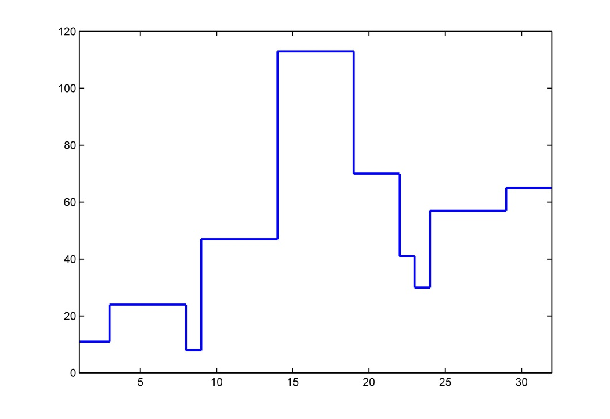
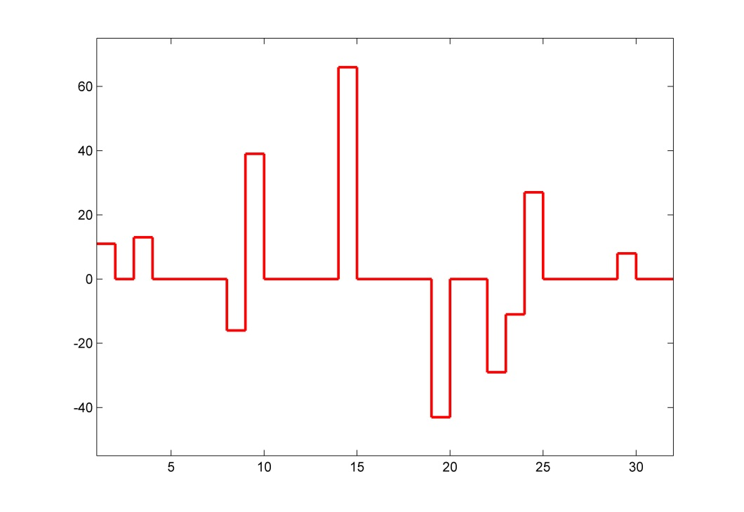
DC Component Coding (DPCM)
DC components from 32 blocks
Differential PCM coding of same
DC components are coded separately from the AC components.

Slide 32
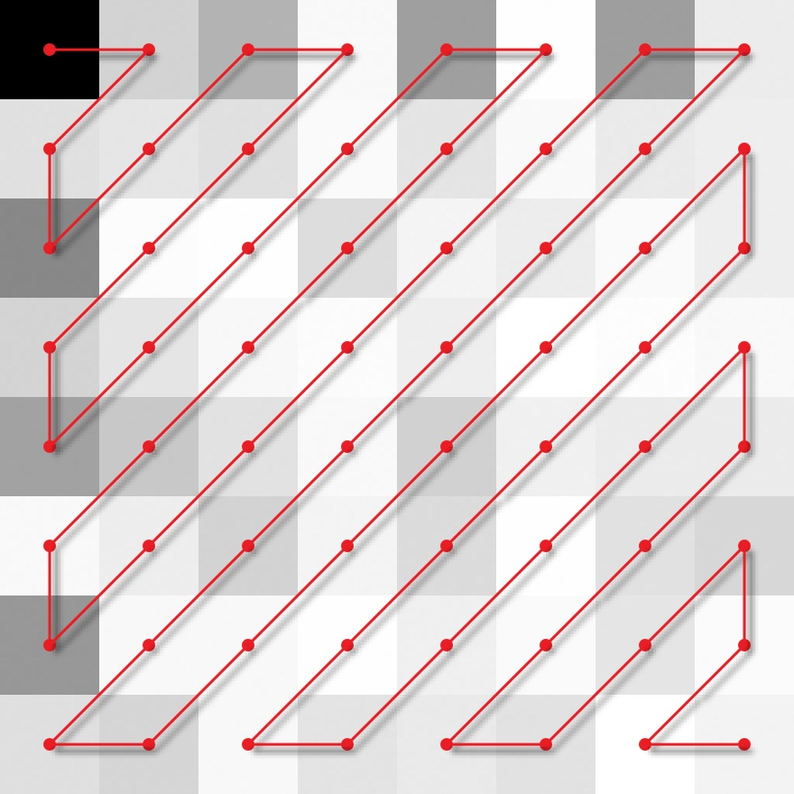
Quantized coefficient encoding order
start
DC
255 23 34 7 15 2 6 1
19 4 10 4 5 1 2 2
29 5 6 1 2 1 1 1
11 9 3 3 1 1 1 1
14 9 2 1 2 1 1 1
3 1 3 1 2 1 1 2
7 1 1 1 1 1 1 1
0 0 1 1 1 0 1 1
end
AC: 23 19 29 4 34 7 10 5 11 14 9 6 4 15 2 5 1 3 9 3 7 1 2 3 2 1 6 1 2 1 1 1 3 1 0 0 1 1 2 1 1 2 1 1 1 2 1 1 1 1 1

Slide 33
Entropy Encoding of AC Coefficients
Two step process:
Convert zigzag sequence of quantized coefficients into a sequence of symbols.
Convert symbols to a data stream of variable length codes.
Symbol 1 = (Runlength, Size)
Symbol 2 = Amplitude

Slide 34
Entropy Encoding of Coefficients
Symbol 1: (Runlength, Size);
Symbol 2: Amplitude
AC:
Runlength: number of consecutive zero values (0-15)
Size: number of bits used to encode amplitude (1-10)
Amplitude: quantized value
DC:
Runlength: not included
Size: number of bits used to encode amplitude (1-11)
Amplitude: quantized value

Slide 35
Variable Length Entropy Encoding
size | amplitude
1 | -1,1
2 | -3,-2,2,3
3 | -7…-4,4…7
4 | -15…-8,8…15
5 | -31…-16,16…31
6 | -63…-32,32…63
7 | -127…-64,64…128
8 | -255…-128,128…255
9 | -511…-256,256…511
10 | -1023…-512,512…1023
11 | -2047…-1024,1024…2047
Symbol 2 Coding
DC only

Slide 36
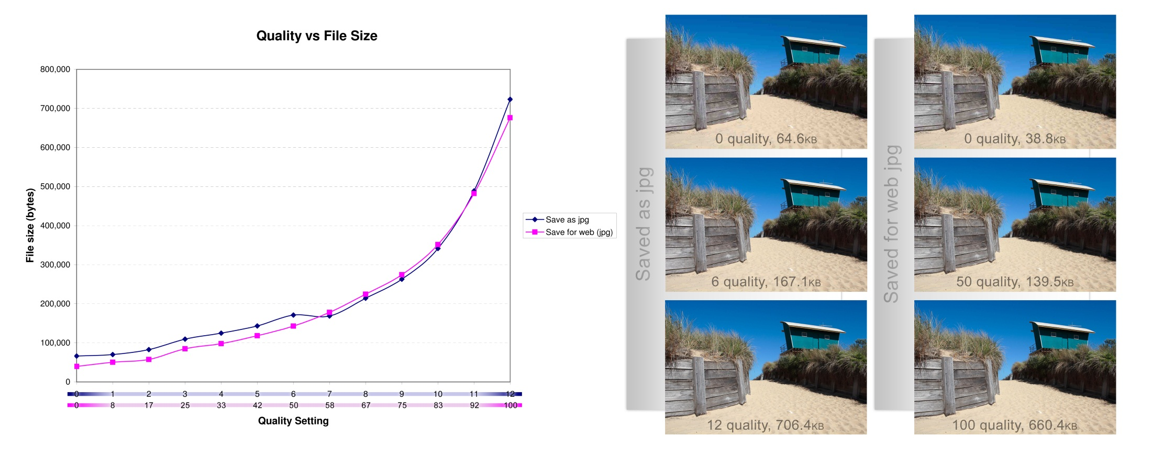
Effects of Quality Settings
Image: http://en.wikipedia.org/wiki/File:Quality_comparison_jpg_vs_saveforweb.jpg

Slide 37
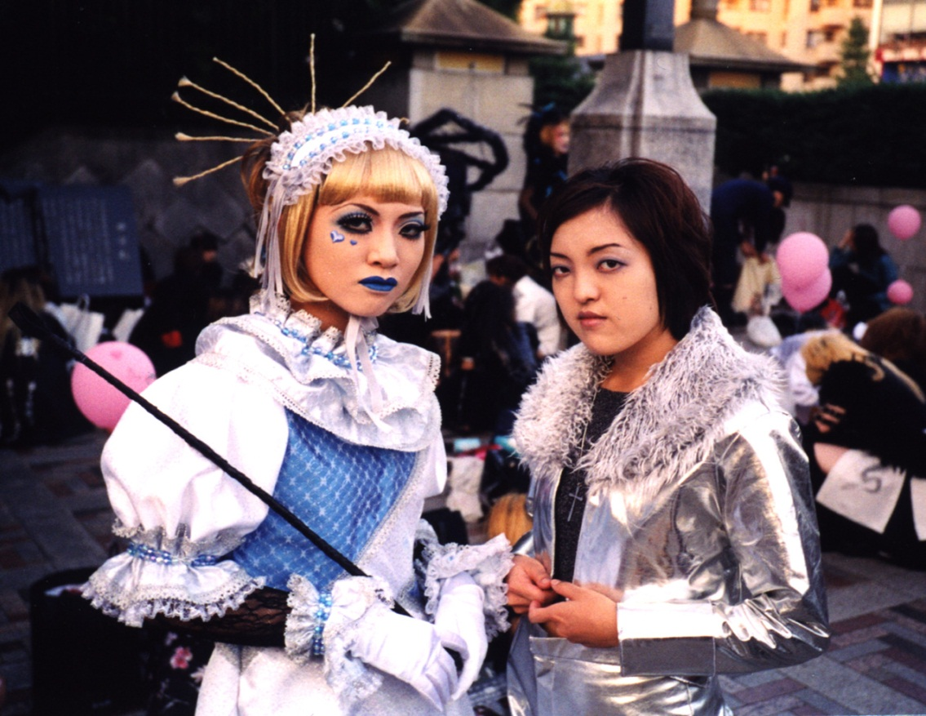
JPEG Compression
Original image is 5244w x 4716h @ 1200 ppi: 127MBytes
Yoyogi Park, Tokyo, October 1999. Photo by Alan Peters.

Slide 38
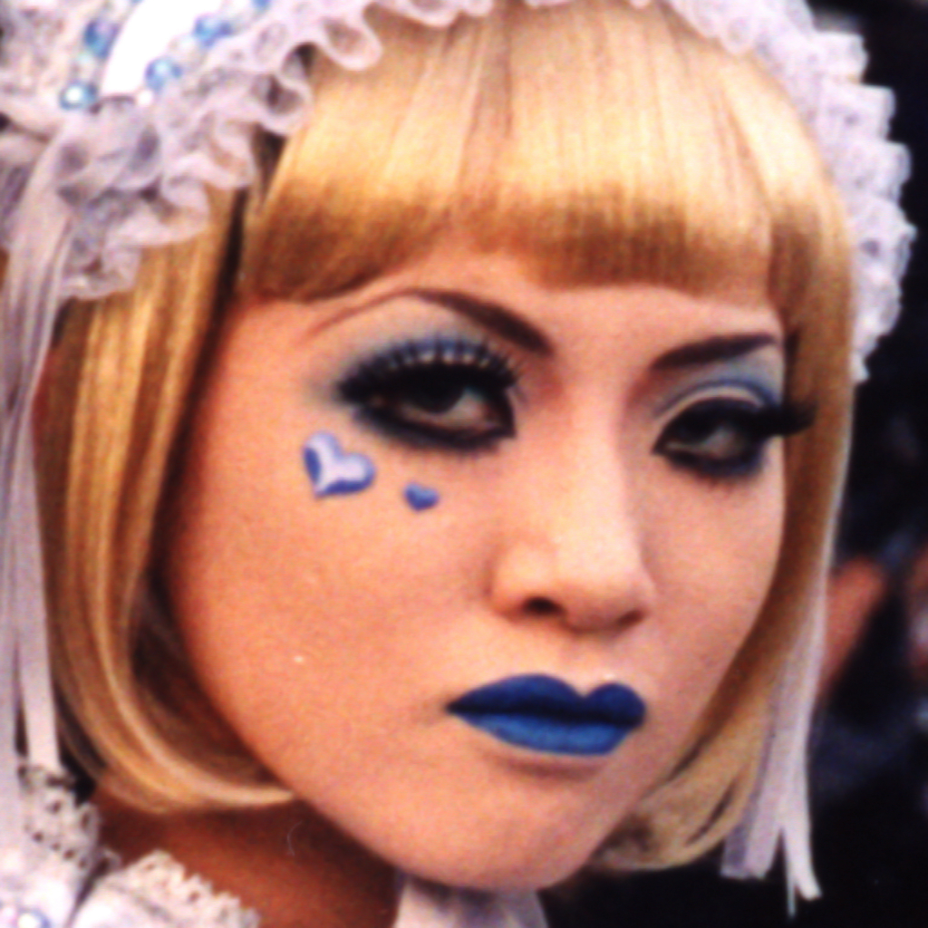
BMP
File size in bytes
3,145,784
Original Image

Slide 39

JPEG
File size in bytes
632,210
Matlab’s quality 100

Slide 40

JPEG
File size in bytes
56,541
Matlab’s quality 50

Slide 41
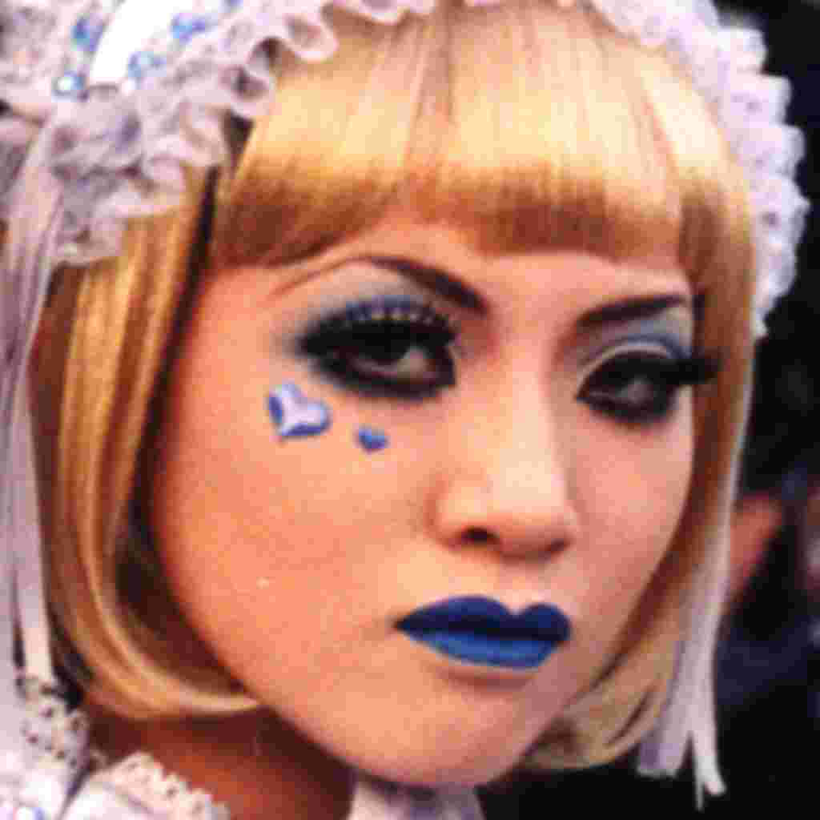
JPEG
File size in bytes
26,262
Matlab’s quality 10

Slide 42
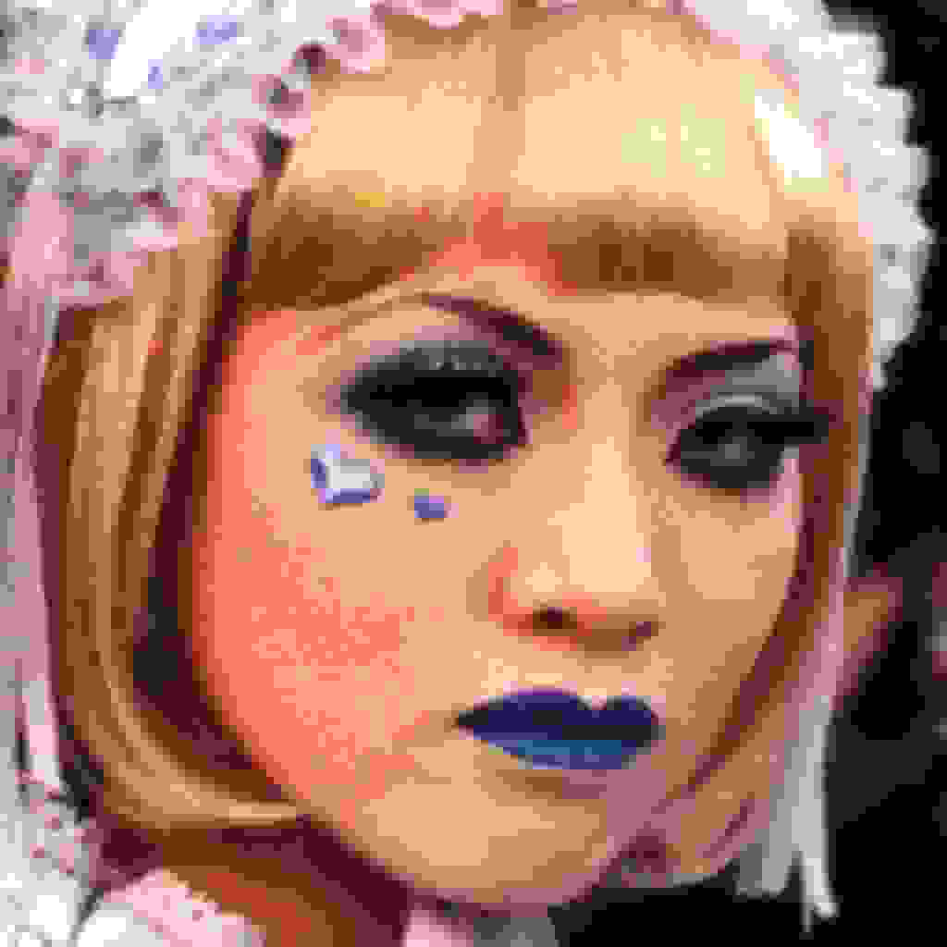
JPEG
File size in bytes
19,117
Matlab’s quality 0
Quality numbers are different between programs…

Slide 43

JPEG
File size in bytes
47,800
Photoshop’s quality 0
Photoshop’s quality zero is similar to Matlab’s quality 40…

Slide 44

JPEG
File size in bytes
49,115
Matlab’s quality 40
Does not matter because the quantization tables are in the file with the data. Each program uses that table when decoding the data.

Slide 45
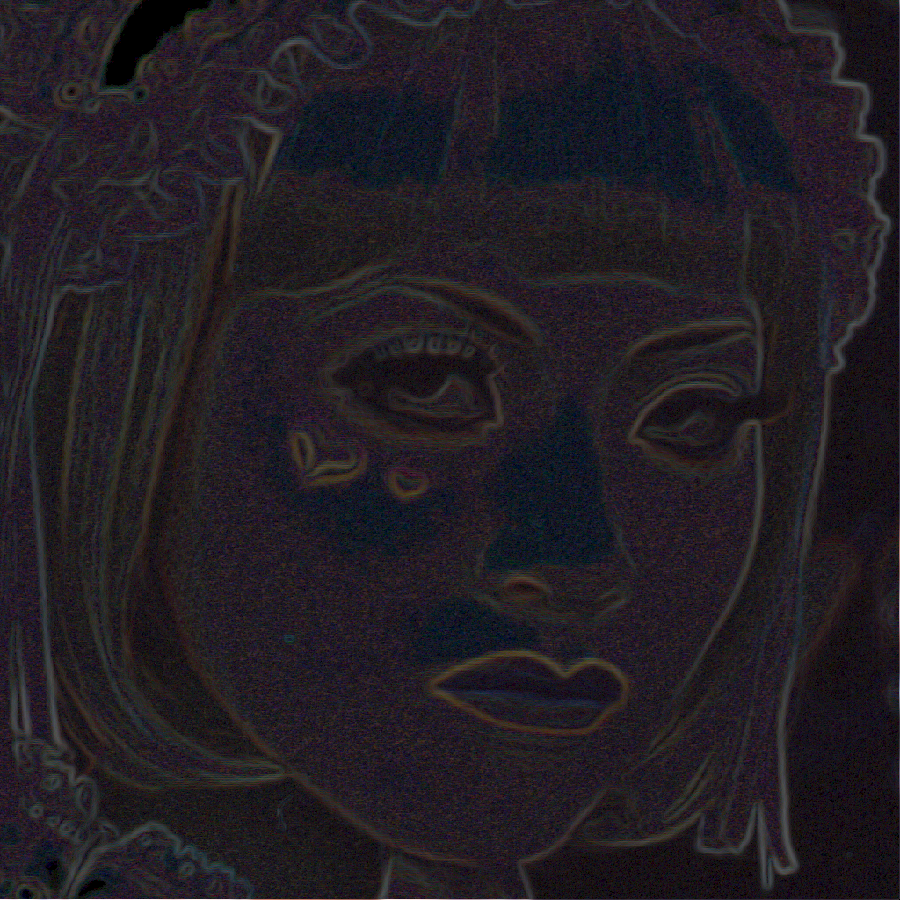
JPEG
Magnitude of Gradient of Original image

Slide 46
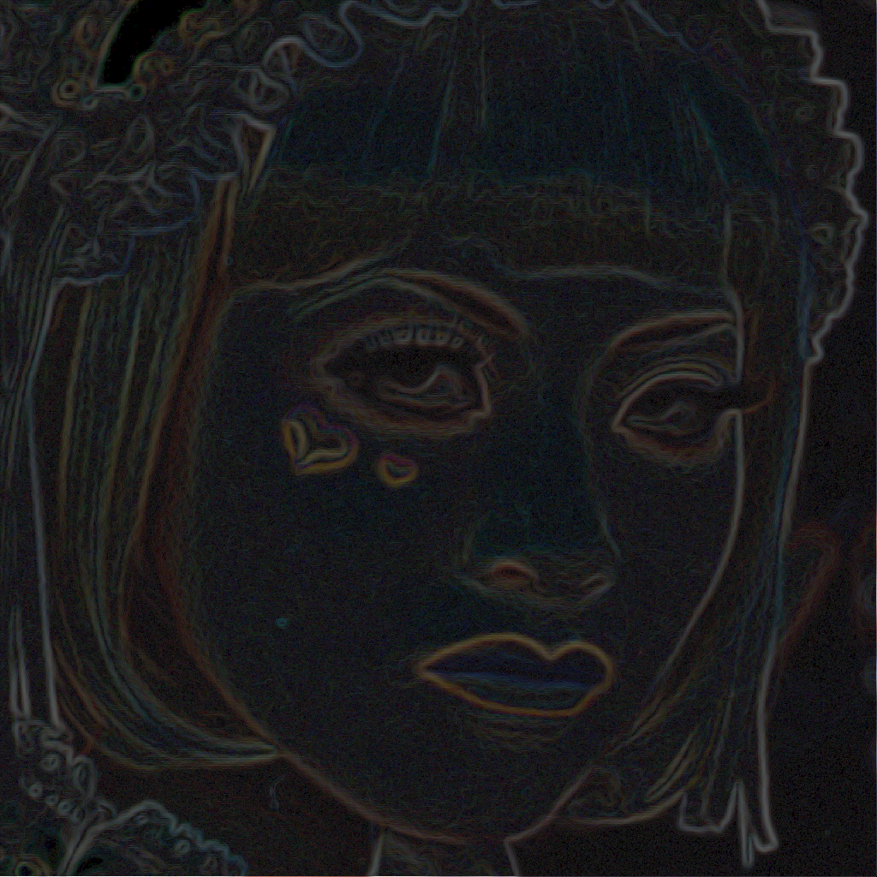
JPEG
Magnitude of gradient of jpeg quality 100 image

Slide 47
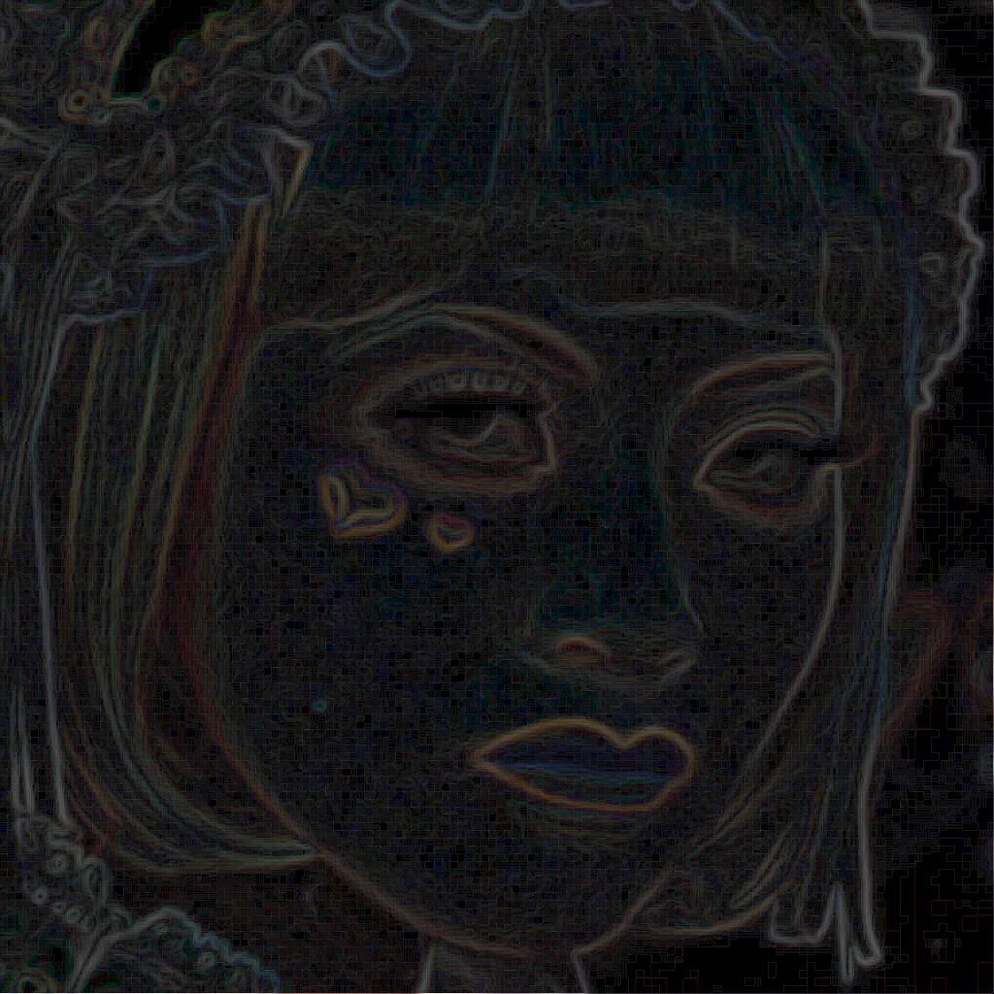
JPEG
Magnitude of gradient of jpeg quality 50 image

Slide 48
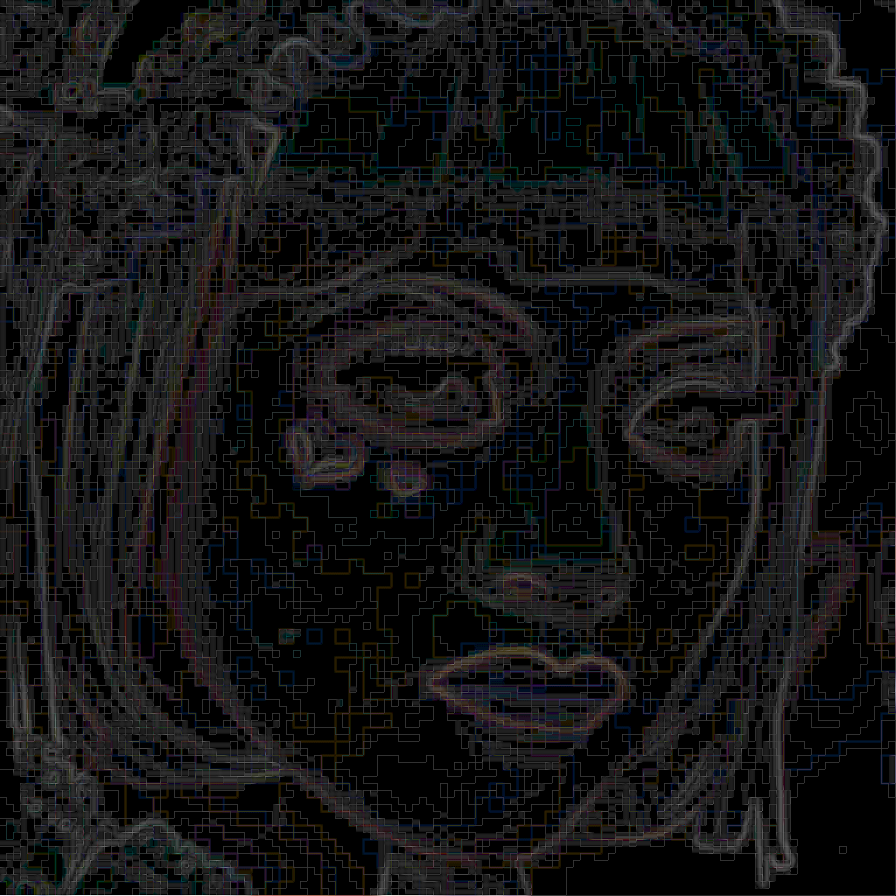
JPEG
Magnitude of gradient of jpeg quality 10 image

Slide 49
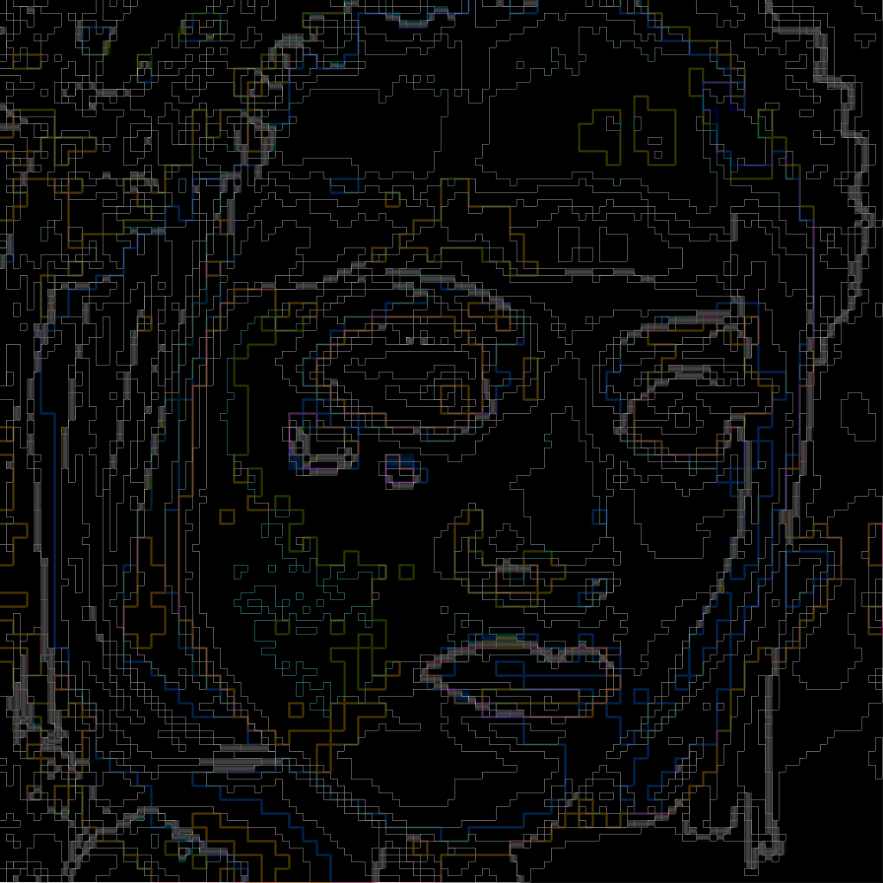
JPEG
Magnitude of gradient of jpeg quality 0 image

Slide 50
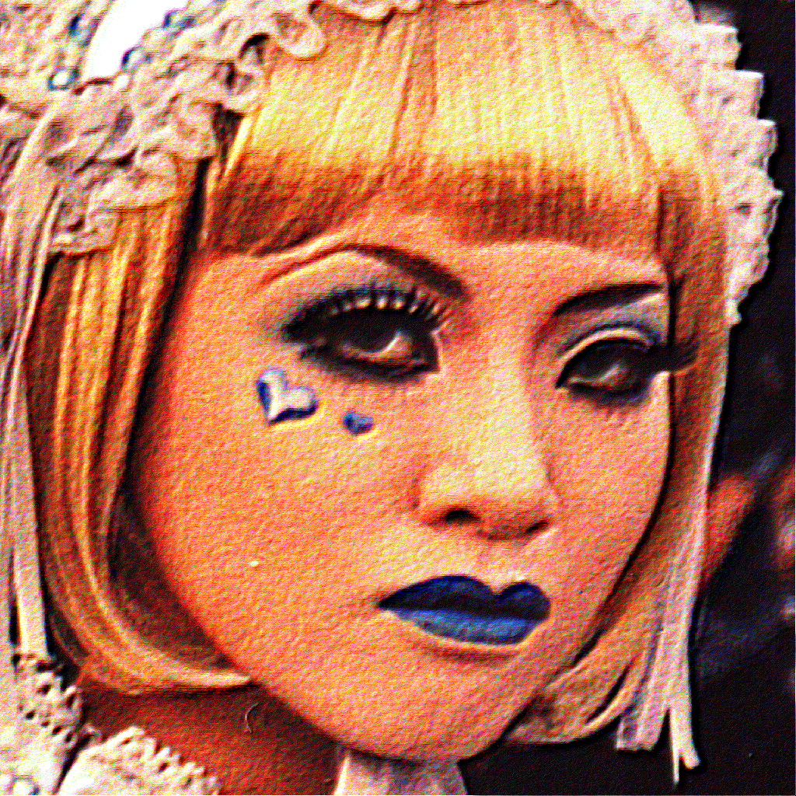
JPEG
Gradient enhanced original image

Slide 51
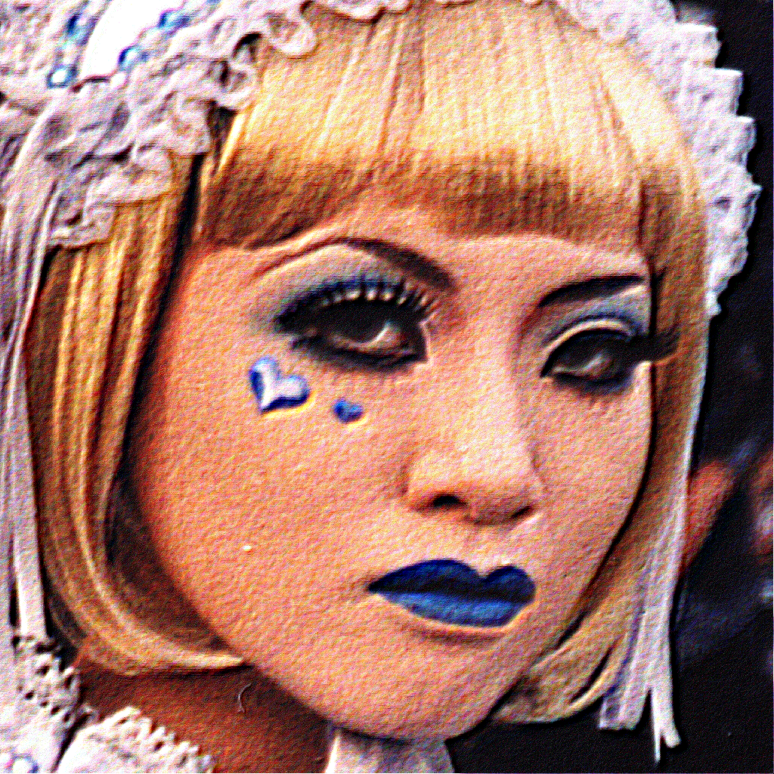
JPEG
Gradient enhanced quality 100 image

Slide 52

JPEG
Gradient enhanced quality 50 image

Slide 53
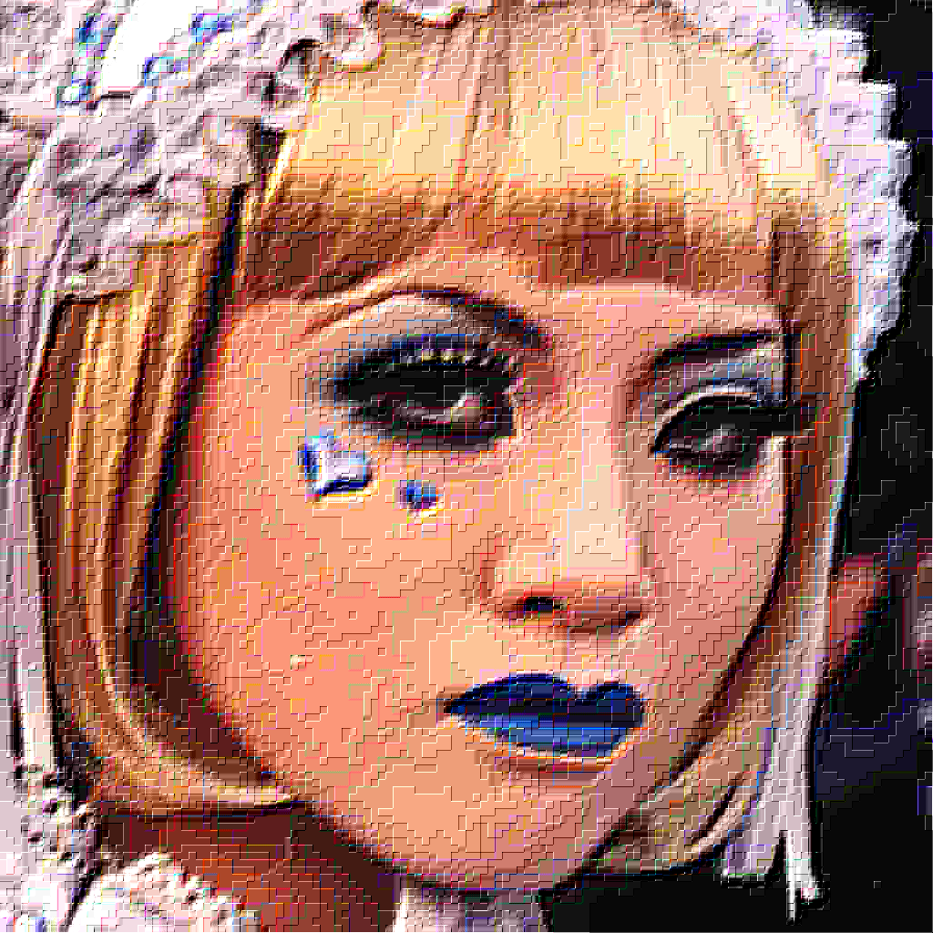
JPEG
Gradient enhanced quality 10 image

Slide 54
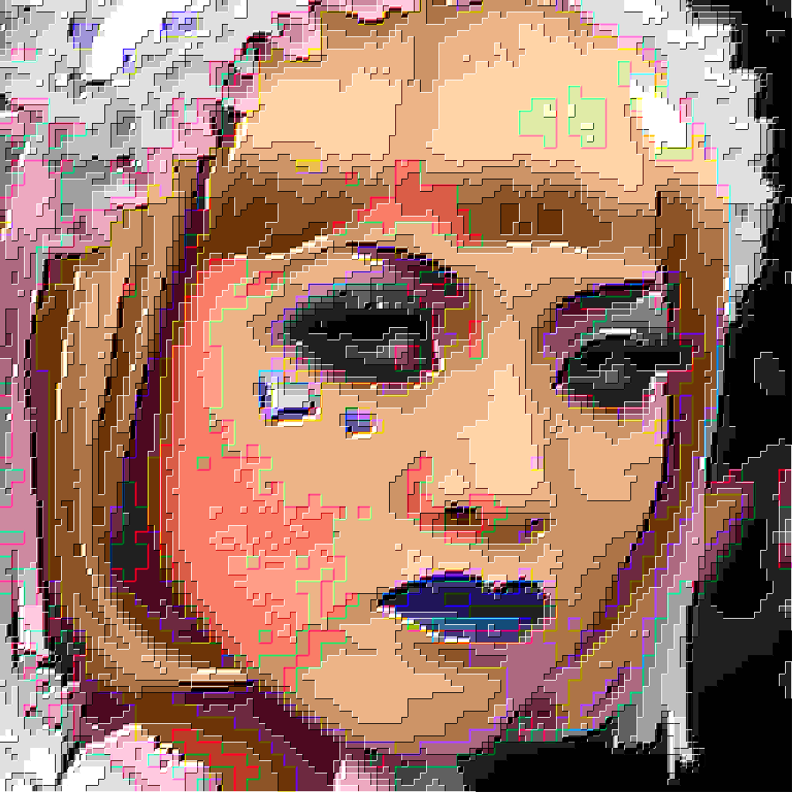
JPEG
Gradient enhanced quality 0 image

Slide 55
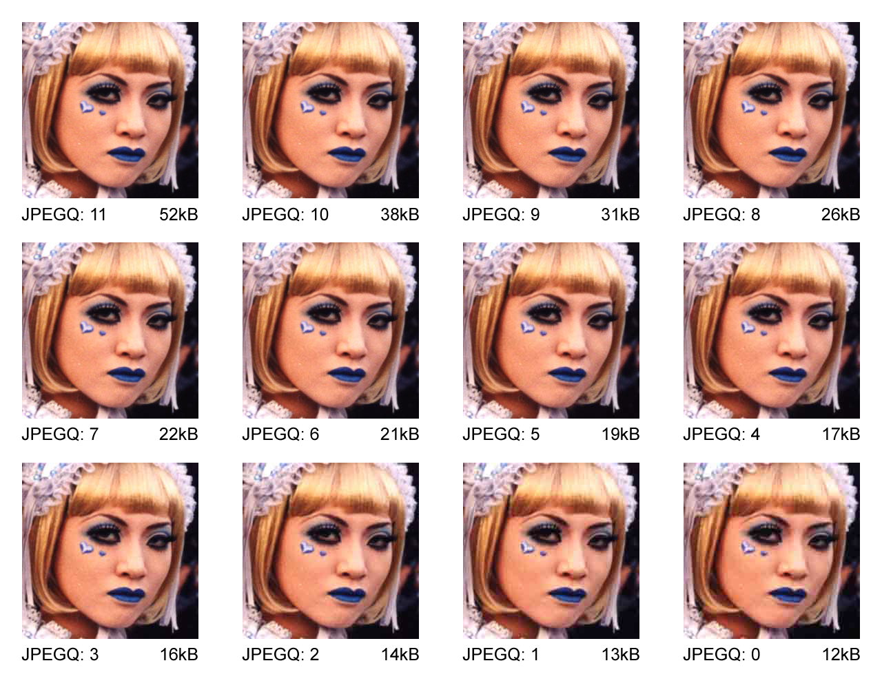
Image Compression: JPEG
File size in bytes
JPEG quality level

Slide 56
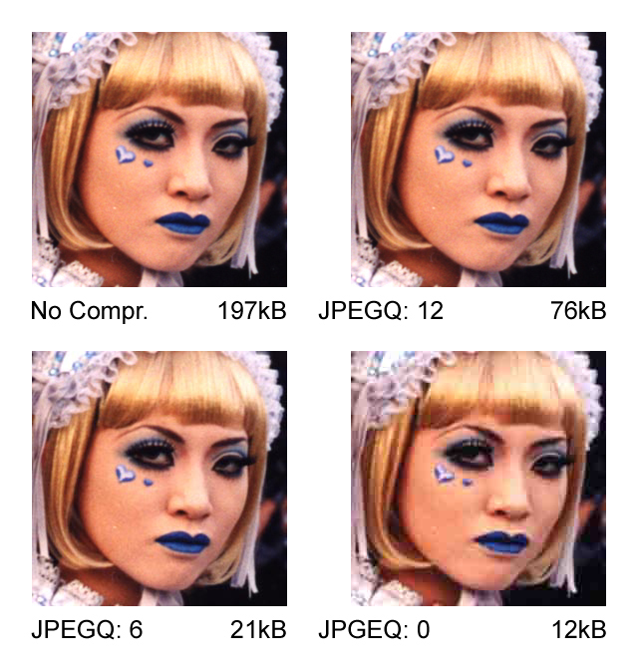
Image Compression: JPEG
File size in bytes
JPEG quality level

Slide 57
JFIF Information Display Program
JPEGsnoop - JPEG File Decoding Utility
by Calvin Hass © 2010
From the web page:
Every digital photo contains a wealth of hidden information -- JPEGsnoop was written to expose these details to those who are curious. Not only can one determine the various settings that were used in the digital camera in taking the photo (EXIF metadata, IPTC), but one can also extract information that indicates the quality and nature of the JPEG image compression used by the camera in saving the file. Digital cameras specify compression quality levels, many of them wildly different, leading to the fact that some cameras produce far better JPEG images than others.
http://www.impulseadventure.com/photo/

Slide 58
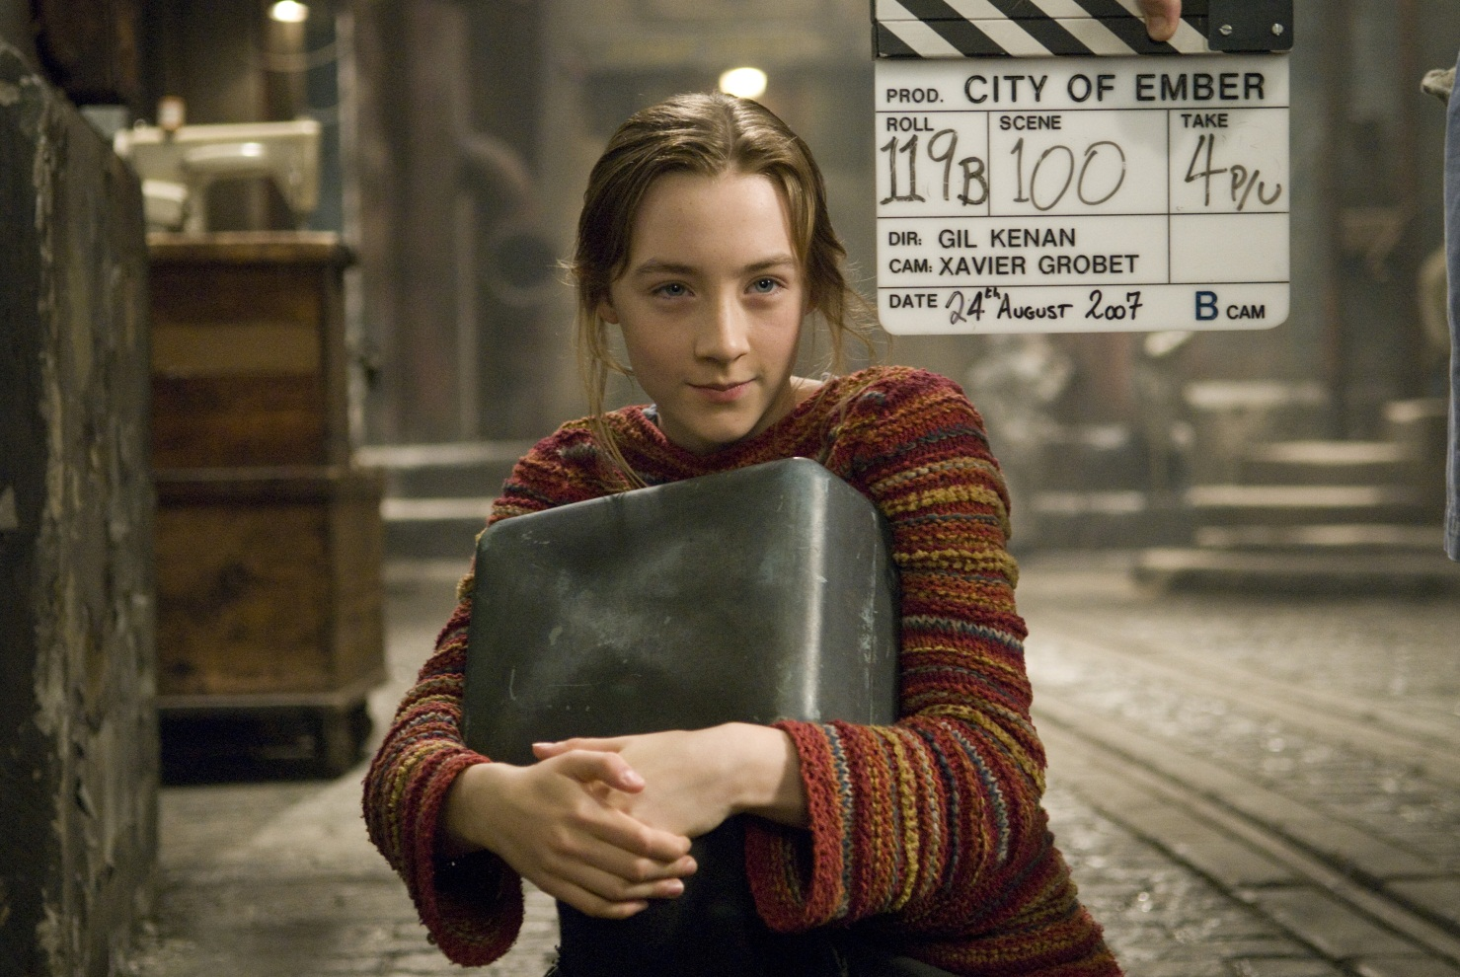
Example: JPEG/JFIF Encoded Image
Keith Hamshere – Soairse Ronan – 2007

Slide 59
Data Markers from the JPEG File Interchange Format (JFIF)
Short name | Code | Payload | Name | Comments
SOI | 0xFFD8 | none | Start Of Image
SOF0 | 0xFFC0 | variable size | Start Of Frame (Baseline) | Indicates that this is a baseline DCT-based JPEG, and specifies the width, height, number of components, and component subsampling (e.g., 4:2:0).
SOF2 | 0xFFC2 | variable size | Start Of Frame (Progressive) | Indicates that this is a progressive DCT-based JPEG, and specifies the width, height, number of components, and component subsampling (e.g., 4:2:0).
DHT | 0xFFC4 | variable size | Define Huffman Table(s) | Specifies one or more Huffman tables.
DQT | 0xFFDB | variable size | Define Quantization Table(s) | Specifies one or more quantization tables.
DRI | 0xFFDD | 2 bytes | Define Restart Interval | Specifies the interval between RSTn markers, in macroblocks. This marker is followed by two bytes indicating the fixed size so it can be treated like any other variable size segment.
SOS | 0xFFDA | variable size | Start Of Scan | Begins a top-to-bottom scan of the image. In baseline DCT JPEG images, there is generally a single scan. Progressive DCT JPEG images usually contain multiple scans. This marker specifies which slice of data it will contain, and is immediately followed by entropy-coded data.
RSTn | 0xFFD0…D7 | none | Restart | Inserted every r macroblocks, where r is the restart interval set by a DRI marker. Not used if there was no DRI marker. The low 3 bits of the marker code cycle in value from 0 to 7.
APPn | 0xFFEn | variable size | Application-specific | For example, an Exif JPEG file uses an APP1 marker to store metadata, laid out in a structure based closely on TIFF.
COM | 0xFFFE | variable size | Comment | Contains a text comment.
EOI | 0xFFD9 | none | End Of Image
Source: ISO/IEC 10918-1:1994, p.36, via http://en.wikipedia.org/wiki/JPEG

Slide 60
JPEG / JFIF Information (via JPEGsnoop)
Filename: [Saoirse Ronan - Ember.jpg]
Filesize: [3156857] Bytes
Start Offset: 0x00000000
*** Marker: SOI (xFFD8) ***
OFFSET: 0x00000000
*** Marker: APP13 (xFFED) ***
OFFSET: 0x00000002
length = 28
Identifier = [Photoshop 3.0]
8BIM: [0x0404] Name=[] Len=[0x0000]
IPTC [0xFFE1:002] ? size=12392
*** Marker: APP1 (xFFE1) ***
OFFSET: 0x00000020
length = 560
Identifier = [http://ns.adobe.com/xap/1.0/]
XMP =
*** Marker: APP0 (xFFE0) ***
OFFSET: 0x00000252
length = 16
identifier = [JFIF]
version = [1.2]
density = 300 x 300 DPI (dots per inch)
thumbnail = 0 x 0
*** Marker: APP2 (xFFE2) ***
OFFSET: 0x00000264
length = 576
Identifier = [ICC_PROFILE]
ICC Profile:
Marker Number = 1 of 1
Profile Size : 560 bytes
Preferred CMM Type : 'ADBE' (0x41444245)
Profile Version : 0.2.1.0 (0x02100000)
Profile Device/Class : Display Device profile ('mntr' (0x6D6E7472))
Data Colour Space : rgbData ('RGB ' (0x52474220))
Profile connection space (PCS) : 'XYZ ' (0x58595A20)
Profile creation date : 1999-06-03 00:00:00
Profile file signature : 'acsp' (0x61637370)
Primary platform : Apple Computer, Inc. ('APPL' (0x4150504C))
Profile flags : 0x00000000
Profile flags > Profile not embedded
Profile flags > Profile can't be used independently of embedded
Device Manufacturer : 'none' (0x6E6F6E65)
Device Model : '....' (0x00000000)
Device attributes : 0x00000000_00000000
Device attributes > Reflective
Device attributes > Glossy
Device attributes > Media polarity = negative
Device attributes > Black & white media
Rendering intent : Perceptual
Profile creator : 'ADBE' (0x41444245)
Profile ID : 0x00000000_00000000_00000000

Slide 61
JPEG / JFIF Information (via JPEGsnoop)
*** Marker: DQT (xFFDB) ***
Define a Quantization Table.
OFFSET: 0x000004B6
Table length = 132
----
Precision=8 bits
Destination ID=0 (Luminance)
DQT, Row #0: 2 2 3 4 5 6 8 11
DQT, Row #1: 2 2 2 4 5 7 9 11
DQT, Row #2: 3 2 3 5 7 9 11 12
DQT, Row #3: 4 4 5 7 9 11 12 12
DQT, Row #4: 5 5 7 9 11 12 12 12
DQT, Row #5: 6 7 9 11 12 12 12 12
DQT, Row #6: 8 9 11 12 12 12 12 12
DQT, Row #7: 11 11 12 12 12 12 12 12
Approx quality factor = 91.64 (scaling=16.71 variance=22.54)
- ---
Precision=8 bits
Destination ID=1 (Chrominance)
DQT, Row #0: 3 3 7 13 15 15 15 15
DQT, Row #1: 3 4 7 13 14 12 12 12
DQT, Row #2: 7 7 13 14 12 12 12 12
DQT, Row #3: 13 13 14 12 12 12 12 12
DQT, Row #4: 15 14 12 12 12 12 12 12
DQT, Row #5: 15 12 12 12 12 12 12 12
DQT, Row #6: 15 12 12 12 12 12 12 12
DQT, Row #7: 15 12 12 12 12 12 12 12
Approx quality factor = 92.57 (scaling=14.85 variance=23.00)
*** Marker: SOF0 (Baseline DCT) (xFFC0) ***
OFFSET: 0x0000053C
Frame header length = 17
Precision = 8
Number of Lines = 2592
Samples per Line = 3872
Image Size = 3872 x 2592
Raw Image Orientation = Landscape
Number of Img components = 3
Comp[1]: ID=0x01, Samp Fac=0x11 (Subsamp 1 x 1), Quant Tbl Sel=0x00 (Lum: Y)
Comp[2]: ID=0x02, Samp Fac=0x11 (Subsamp 1 x 1), Quant Tbl Sel=0x01 (Chrom: Cb)
Comp[3]: ID=0x03, Samp Fac=0x11 (Subsamp 1 x 1), Quant Tbl Sel=0x01 (Chrom: Cr)
*** Marker: DRI (Restart Interval) (xFFDD) ***
OFFSET: 0x0000054F
length = 4
interval = 484

Slide 62
JPEG / JFIF Information (via JPEGsnoop)
*** Marker: DHT (Define Huffman Table) (xFFC4) ***
OFFSET: 0x00000555
Huffman table length = 418
----
Destination ID = 0
Class = 0 (DC / Lossless Table)
Codes of length 01 bits (000 total):
Codes of length 02 bits (000 total):
Codes of length 03 bits (007 total): 04 05 03 02 06 01 00
Codes of length 04 bits (001 total): 07
Codes of length 05 bits (001 total): 08
Codes of length 06 bits (001 total): 09
Codes of length 07 bits (001 total): 0A
Codes of length 08 bits (001 total): 0B
Codes of length 09 bits (000 total):
Codes of length 10 bits (000 total):
Codes of length 11 bits (000 total):
Codes of length 12 bits (000 total):
Codes of length 13 bits (000 total):
Codes of length 14 bits (000 total):
Codes of length 15 bits (000 total):
Codes of length 16 bits (000 total):
Total number of codes: 012
----
Destination ID = 1
Class = 0 (DC / Lossless Table)
Codes of length 01 bits (000 total):
Codes of length 02 bits (002 total): 01 00
Codes of length 03 bits (002 total): 02 03
Codes of length 04 bits (003 total): 04 05 06
Codes of length 05 bits (001 total): 07
Codes of length 06 bits (001 total): 08
Codes of length 07 bits (001 total): 09
Codes of length 08 bits (001 total): 0A
Codes of length 09 bits (001 total): 0B
Codes of length 10 bits (000 total):
Codes of length 11 bits (000 total):
Codes of length 12 bits (000 total):
Codes of length 13 bits (000 total):
Codes of length 14 bits (000 total):
Codes of length 15 bits (000 total):
Codes of length 16 bits (000 total):
Total number of codes: 012

Slide 63
JPEG / JFIF Information (via JPEGsnoop)
----
Destination ID = 0
Class = 1 (AC Table)
Codes of length 01 bits (000 total):
Codes of length 02 bits (002 total): 01 02
Codes of length 03 bits (001 total): 03
Codes of length 04 bits (003 total): 11 04 00
Codes of length 05 bits (003 total): 05 21 12
Codes of length 06 bits (002 total): 31 41
Codes of length 07 bits (004 total): 51 06 13 61
Codes of length 08 bits (002 total): 22 71
Codes of length 09 bits (006 total): 81 14 32 91 A1 07
Codes of length 10 bits (007 total): 15 B1 42 23 C1 52 D1
Codes of length 11 bits (003 total): E1 33 16
Codes of length 12 bits (004 total): 62 F0 24 72
Codes of length 13 bits (002 total): 82 F1
Codes of length 14 bits (006 total): 25 43 34 53 92 A2
Codes of length 15 bits (002 total): B2 63
Codes of length 16 bits (115 total):
73 C2 35 44 27 93 A3 B3 36 17 54 64 74 C3 D2 E2
08 26 83 09 0A 18 19 84 94 45 46 A4 B4 56 D3 55
28 1A F2 E3 F3 C4 D4 E4 F4 65 75 85 95 A5 B5 C5
D5 E5 F5 66 76 86 96 A6 B6 C6 D6 E6 F6 37 47 57
67 77 87 97 A7 B7 C7 D7 E7 F7 38 48 58 68 78 88
98 A8 B8 C8 D8 E8 F8 29 39 49 59 69 79 89 99 A9
B9 C9 D9 E9 F9 2A 3A 4A 5A 6A 7A 8A 9A AA BA CA
DA EA FA
Total number of codes: 162
----
Destination ID = 1
Class = 1 (AC Table)
Codes of length 01 bits (000 total):
Codes of length 02 bits (002 total): 01 00
Codes of length 03 bits (002 total): 02 11
Codes of length 04 bits (001 total): 03
Codes of length 05 bits (002 total): 04 21
Codes of length 06 bits (003 total): 12 31 41
Codes of length 07 bits (005 total): 05 51 13 61 22
Codes of length 08 bits (005 total): 06 71 81 91 32
Codes of length 09 bits (004 total): A1 B1 F0 14
Codes of length 10 bits (005 total): C1 D1 E1 23 42
Codes of length 11 bits (006 total): 15 52 62 72 F1 33
Codes of length 12 bits (004 total): 24 34 43 82
Codes of length 13 bits (008 total): 16 92 53 25 A2 63 B2 C2
Codes of length 14 bits (003 total): 07 73 D2
Codes of length 15 bits (003 total): 35 E2 44
Codes of length 16 bits (109 total):
83 17 54 93 08 09 0A 18 19 26 36 45 1A 27 64 74
55 37 F2 A3 B3 C3 28 29 D3 E3 F3 84 94 A4 B4 C4
D4 E4 F4 65 75 85 95 A5 B5 C5 D5 E5 F5 46 56 66
76 86 96 A6 B6 C6 D6 E6 F6 47 57 67 77 87 97 A7
B7 C7 D7 E7 F7 38 48 58 68 78 88 98 A8 B8 C8 D8
E8 F8 39 49 59 69 79 89 99 A9 B9 C9 D9 E9 F9 2A
3A 4A 5A 6A 7A 8A 9A AA BA CA DA EA FA
Total number of codes: 162

Slide 64
JPEG / JFIF Information (via JPEGsnoop)
*** Marker: SOS (Start of Scan) (xFFDA) ***
OFFSET: 0x000006F9
Scan header length = 12
Number of img components = 3
Component[1]: selector=0x01, table=0x00
Component[2]: selector=0x02, table=0x11
Component[3]: selector=0x03, table=0x11
Spectral selection = 0 .. 63
Successive approximation = 0x00
*** Decoding SCAN Data ***
OFFSET: 0x00000707
Scan Decode Mode: No IDCT (DC only)
NOTE: Low-resolution DC component shown.
Scan Data encountered marker
0xFFD9 @ 0x00302B77.0
Compression stats:
Compression Ratio: 3028.43:1
Bits per pixel: 0.01:1
Huffman code histogram stats:
Huffman Table: (Dest ID: 0, Class: DC)
# codes of length 01 bits: 0 ( 0%)
# codes of length 02 bits: 0 ( 0%)
# codes of length 03 bits: 142702 ( 91%)
# codes of length 04 bits: 8490 ( 5%)
# codes of length 05 bits: 3974 ( 3%)
# codes of length 06 bits: 1649 ( 1%)
# codes of length 07 bits: 1 ( 0%)
# codes of length 08 bits: 0 ( 0%)
# codes of length 09 bits: 0 ( 0%)
# codes of length 10 bits: 0 ( 0%)
# codes of length 11 bits: 0 ( 0%)
# codes of length 12 bits: 0 ( 0%)
# codes of length 13 bits: 0 ( 0%)
# codes of length 14 bits: 0 ( 0%)
# codes of length 15 bits: 0 ( 0%)
# codes of length 16 bits: 0 ( 0%)
Huffman Table: (Dest ID: 1, Class: DC)
# codes of length 01 bits: 0 ( 0%)
# codes of length 02 bits: 162056 ( 52%)
# codes of length 03 bits: 128895 ( 41%)
# codes of length 04 bits: 22673 ( 7%)
# codes of length 05 bits: 8 ( 0%)
# codes of length 06 bits: 0 ( 0%)
# codes of length 07 bits: 0 ( 0%)
# codes of length 08 bits: 0 ( 0%)
# codes of length 09 bits: 0 ( 0%)
# codes of length 10 bits: 0 ( 0%)
# codes of length 11 bits: 0 ( 0%)
# codes of length 12 bits: 0 ( 0%)
# codes of length 13 bits: 0 ( 0%)
# codes of length 14 bits: 0 ( 0%)
# codes of length 15 bits: 0 ( 0%)
# codes of length 16 bits: 0 ( 0%)

Slide 65
JPEG / JFIF Information (via JPEGsnoop)
YCC clipping in DC:
Y component: [<0= 0] [>255= 0]
Cb component: [<0= 0] [>255= 0]
Cr component: [<0= 0] [>255= 0]
RGB clipping in DC:
R component: [<0= 0] [>255= 0]
G component: [<0= 0] [>255= 0]
B component: [<0= 0] [>255= 0]
Average Pixel Luminance (Y):
Y=[ 86] (range: 0..255)
Brightest Pixel Search:
YCC=[ 1016, 0, 0]
RGB=[255,255,255] @ MCU[ 94, 1]
Finished Decoding SCAN Data
Number of RESTART markers decoded: 323
Next position in scan buffer:
Offset 0x00302B75.1
Huffman Table: (Dest ID: 0, Class: AC)
# codes of length 01 bits: 0 ( 0%)
# codes of length 02 bits: 2103874 ( 53%)
# codes of length 03 bits: 393151 ( 10%)
# codes of length 04 bits: 712367 ( 18%)
# codes of length 05 bits: 368952 ( 9%)
# codes of length 06 bits: 148211 ( 4%)
# codes of length 07 bits: 116694 ( 3%)
# codes of length 08 bits: 52460 ( 1%)
# codes of length 09 bits: 49772 ( 1%)
# codes of length 10 bits: 19533 ( 0%)
# codes of length 11 bits: 2118 ( 0%)
# codes of length 12 bits: 2566 ( 0%)
# codes of length 13 bits: 726 ( 0%)
# codes of length 14 bits: 367 ( 0%)
# codes of length 15 bits: 24 ( 0%)
# codes of length 16 bits: 1861 ( 0%)
Huffman Table: (Dest ID: 1, Class: AC)
# codes of length 01 bits: 0 ( 0%)
# codes of length 02 bits: 580346 ( 62%)
# codes of length 03 bits: 209085 ( 22%)
# codes of length 04 bits: 25344 ( 3%)
# codes of length 05 bits: 50682 ( 5%)
# codes of length 06 bits: 50395 ( 5%)
# codes of length 07 bits: 10862 ( 1%)
# codes of length 08 bits: 2482 ( 0%)
# codes of length 09 bits: 2378 ( 0%)
# codes of length 10 bits: 941 ( 0%)
# codes of length 11 bits: 273 ( 0%)
# codes of length 12 bits: 0 ( 0%)
# codes of length 13 bits: 1 ( 0%)
# codes of length 14 bits: 0 ( 0%)
# codes of length 15 bits: 0 ( 0%)
# codes of length 16 bits: 0 ( 0%)
65

Slide 66
JPEG / JFIF Information (via JPEGsnoop)
*** Marker: EOI (End of Image) (xFFD9) ***
OFFSET: 0x00302B77
*** Searching Compression Signatures ***
Signature: 0166B0BC0B82C8233430BF67FA31C829
Signature (Rotated): 0166B0BC0B82C8233430BF67FA31C829
File Offset: 0 bytes
Chroma subsampling: 1x1
EXIF Make/Model: NONE
EXIF Makernotes: NONE
EXIF Software: NONE
Searching Compression Signatures: (3327 built-in, 0 user(*) )
EXIF.Make / Software EXIF.Model Quality Subsamp Match?
------------------------- ----------------------------------- ---------------- --------------
SW :[Adobe Photoshop] [Save As 10]
Based on the analysis of compression characteristics and EXIF metadata:
ASSESSMENT: Class 1 - Image is processed/edited
Position Marked @ MCU=[ 177, 52](0,0) YCC=[ -468, -60, 30]

